Slide 1

Making powerful science: an introduction to NGS and beyond
Martin Philpott
Team Leader in Systems Biology of Uterine Fibroids
& Director Botnar Sequencing Facility
Botnar Research Centre

Slide 2
Next Generation Sequencing
Next Generation Sequencing refers to methods developed after Sanger sequencing that offer greatly increase throughput at reduced cost per base
Methods newer than NGS are referred to as third generation

Slide 3
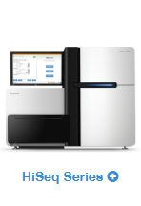
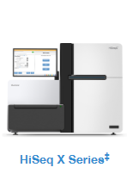
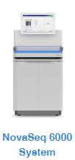
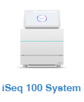
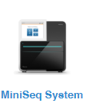
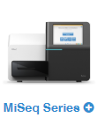
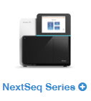
Illumina Sequencing
Maximum Reads Per Run | 4 million | 25 million | 25 million | 150 - 400 million | 5 billion | 6 billion | 1.6 - 20 billion
Maximum Read Length | 2 × 150 bp | 2 × 150 bp | 2 × 300 bp | 2 × 150 bp | 2 × 150 bp | 2 × 150 bp | 2 × 150 bp
The Illumina family of sequencers all use sequencing by synthesis (SBS) technology

Slide 4
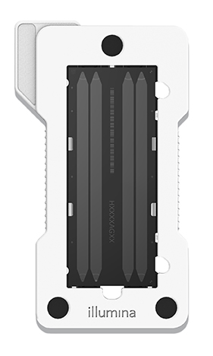
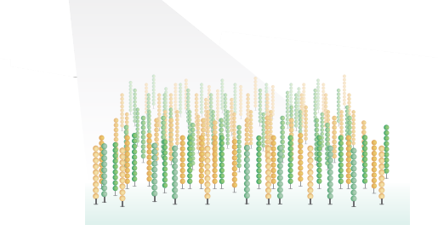
Sequencing by Synthesis

Slide 5


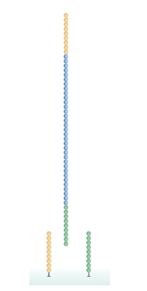
Sequencing by Synthesis
DNA
or
RNA
Library production
Denaturation
Index 2
Adaptors
Index 1
P5
P7
Sequence of interest
Hybridisation to flowcell

Slide 6
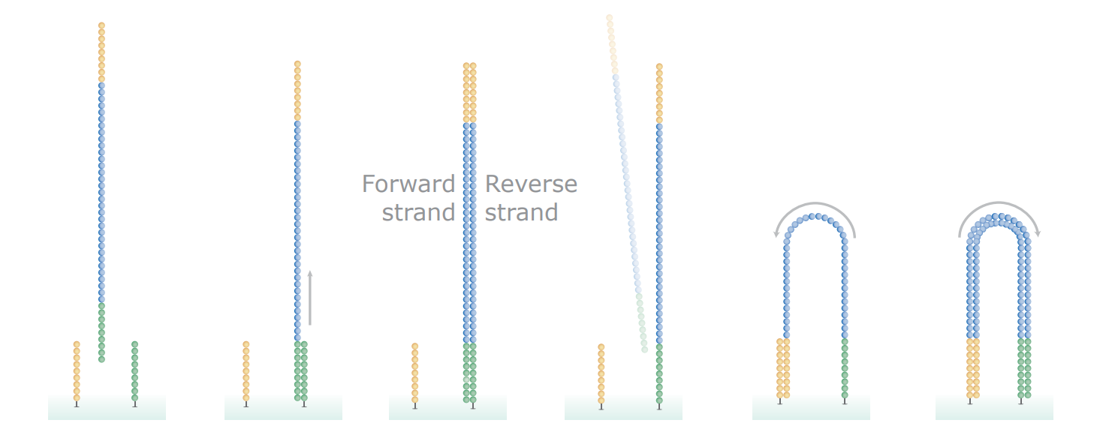
Sequencing by Synthesis
Only reverse strand is anchored
Forward
strand
Reverse
strand
Hybridisation to flowcell
Reverse
strand
synthesis
Remove forward strand
Reverse strand can hybridise to second primer
Synthesise second strand

Slide 7
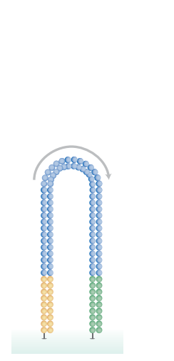
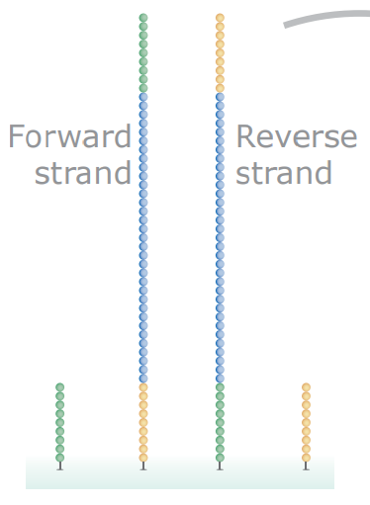
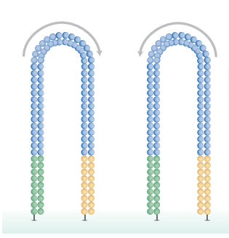
Sequencing by Synthesis
Forward
strand
Reverse
strand
Bridge
Amplification
Denature

Slide 8
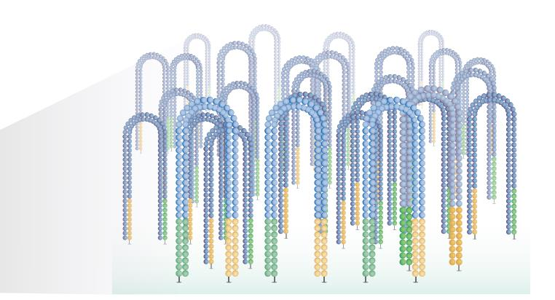
Sequencing by Synthesis
Thousands of molecules are amplified to form clusters with the same sequence

Slide 9
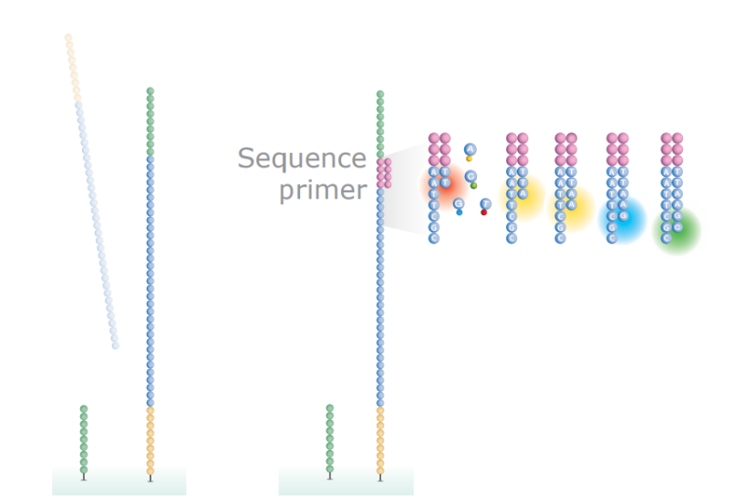
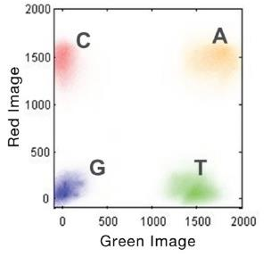
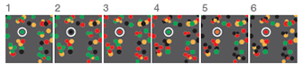
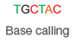
Sequencing by Synthesis
1
2
3
4
5
6
Sequence
primer
NextSeq chemistry uses only two
dyes. C is red, T is green, A is both
(yellow) and G has no dye (no
fluorescent signal)
Before the next chemistry cycle proceeds, the blocked 3’ end and the fluorophore from each incorporated base is removed, to allow incorporation of the next base
The reverse strand is cleaved (USER) and washed away, p5 ends are blocked
With each cycle, fluorescently tagged nucleotides are incorporated into the growing chains and clusters are imaged

Slide 10
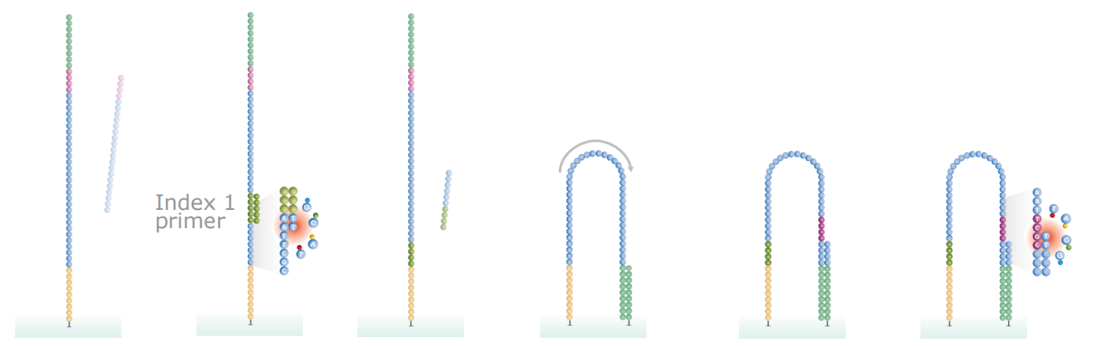
Sequencing by Synthesis
Index 1
primer
The read product is washed
away
Index 1 is sequenced
The read product is washed
away
Hybridise
to P5 oligo
Deblock P5
oligo and add
unlabelled bases
Index 2 is sequenced

Slide 11
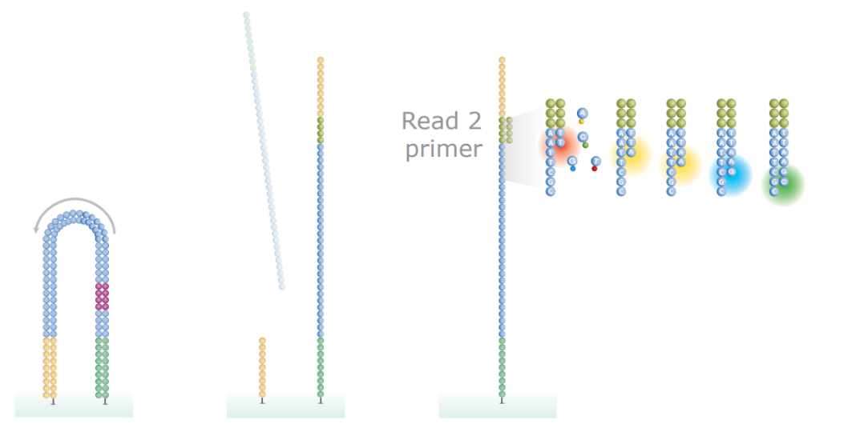
Sequencing by Synthesis
Read 2
primer
Synthesise second
strand
The forward strand is cleaved (Fpg) and washed away
The second
read is
sequenced

Slide 12
Library production
Library production will vary depending on what sequencing-based methodology is being performed
RNAseq
ChIPseq
ATACseq
scRNAseq

Slide 13
Library production: RNAseq
RNAseq quantitatively interrogates the all the RNA transcripts of a population of cells at a given point in time (transcriptomics)
In practice, it is difficult (and more costly) to examine all types of RNA simultaneously, so target RNA is specifically isolated
Also, ~85% of cellular RNA is ribosomal and is usually not of interest
PolyA selection: Selects almost all protein coding mRNA and some lncRNA
Ribosomal depletion: Selects all mRNA and lncRNA, but is considerably more expensive than polyA selection
Small non-coding RNA selection: Selects miRNAs, piRNAs, snoRNAs, snRNAs etc. Method of total RNA extraction is important.

Slide 14
Library production: RNAseq
A wide range of commercial RNAseq library prep kits are available, most of which use fairly similar principles
Illumina produce the TruSeq Stranded mRNA kit
At the Botnar, we use the more economical NEBNext Ultra II Directional RNA Library Prep Kit for Illumina
Both of these are stranded or directional protocols, meaning you can tell which strand the mRNA came from
Some regions of the genome produce overlapping transcripts from opposite strands (one is usually a non-coding antisense regulatory RNA)
Unstranded library prep could not distinguish between these two transcripts

Slide 15
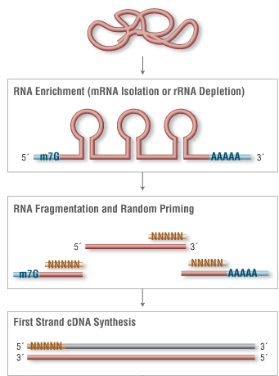
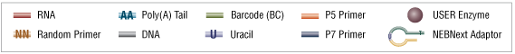
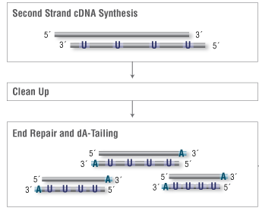
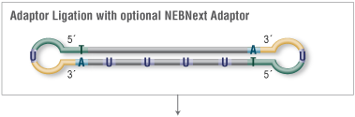
Library production: RNAseq
polyT labelled magnetic beads
or
rRNA probes followed by RNAse H digest or bead capture
DNA polymerase I
AMPure XP paramagnetic beads
Mixture of mesophilic DNA polymerase
and thermophilic Taq polymerase?
94°C for ~15 minutes
Reverse transcriptase
T4 DNA Ligase

Slide 16
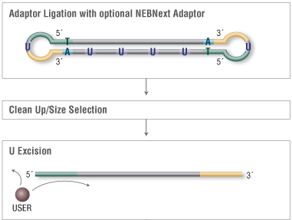
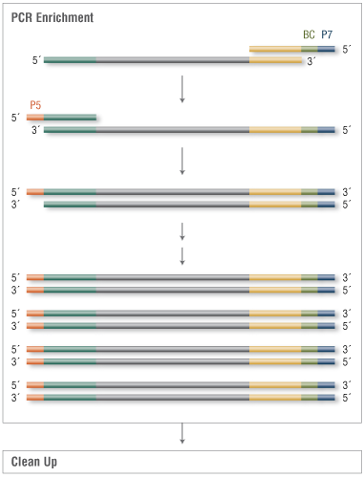

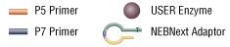
Library production: RNAseq
PCR primers add P5, P7 and index sequences
T4 DNA Ligase
AMPure XP paramagnetic beads
USER enzyme is a mixture of E. coli uracil DNA glycosylase and endonuclease VIII. Together, these enzymes excise uracils, creating single stranded DNA breaks

Slide 17
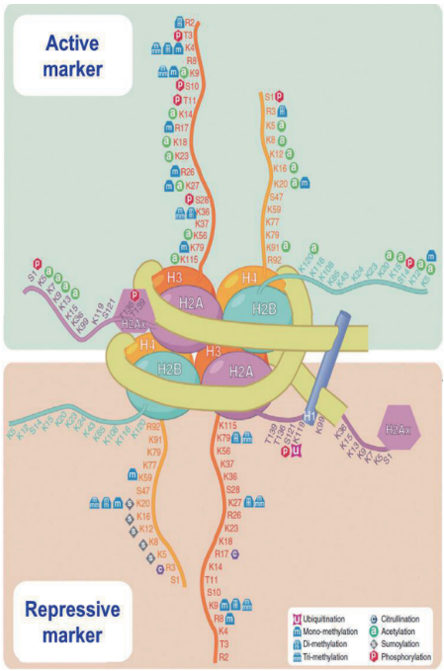
Library production: ChIPseq
ChIPseq allows the mapping of specific proteins or post-translationally modified proteins (particularly histones) to DNA
Open Chromatin

Activation
Histone tails can be modified
Methylation
Acetyation
Phosphorylation
Leads to changes in chromatin conformation
This process is regulated by a number of enzymes
Methyltransferases
Demethylases
Acetylases
Deacetylases
Transcription factors
Chromatin modifiers
Condensed Chromatin

Repression

Slide 18
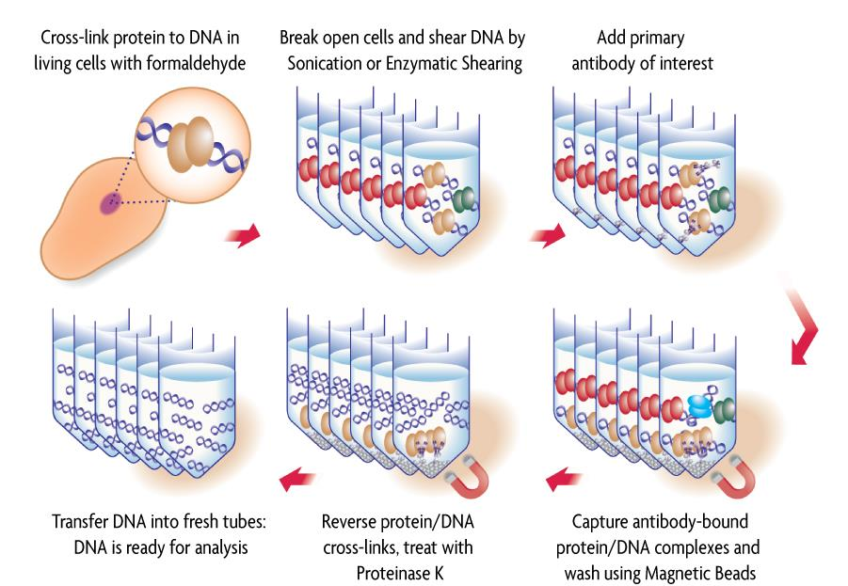
Library production: ChIPseq
https://www.activemotif.com/catalog/507/chip-it-express-high-throughput

Slide 19
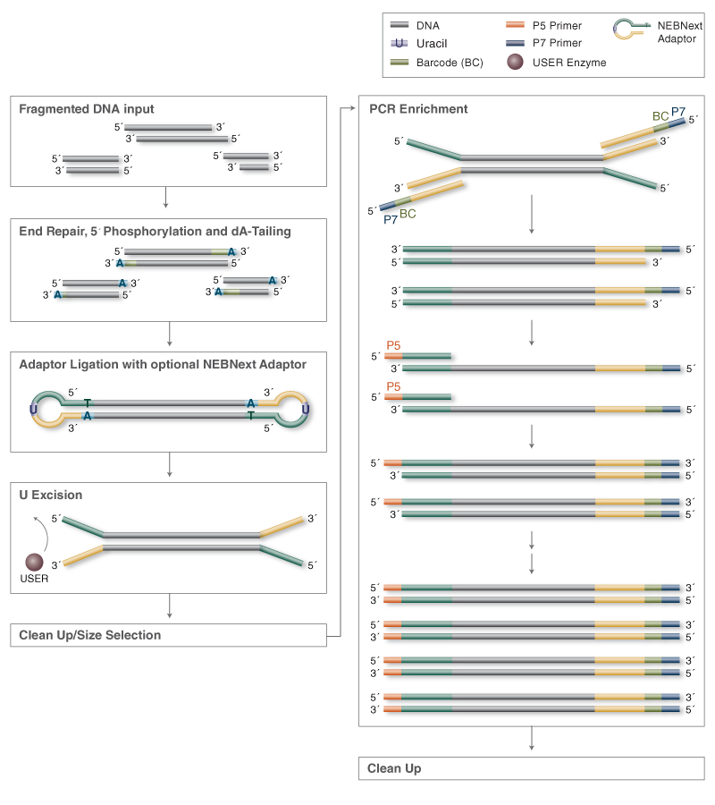
Library production: DNA (ChIPseq, WGS…)
Protocol the same as RNA library prep from end repair step onwards
Does not need to be stranded (both strands will map to the same location)

Slide 20
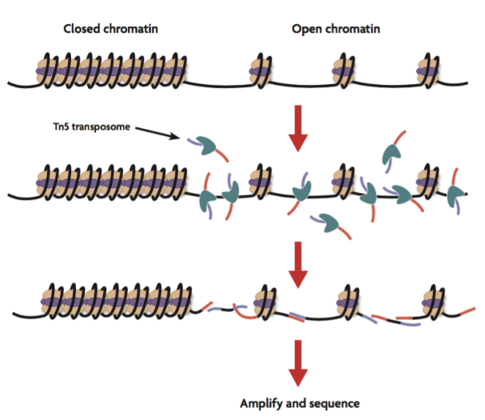
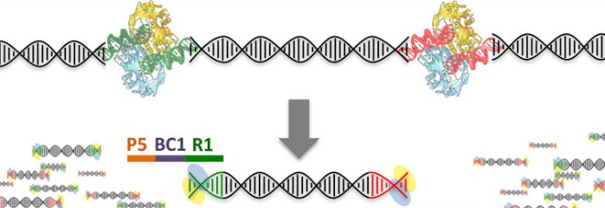
Library production: ATACseq
ATACseq (Assay for Transposase-Accessible Chromatin using sequencing) is a technique used to study chromatin accessibility
It is particularly useful for identifying regulatory regions, e.g. promoters, enhancers, insulators
It is based on the concept that open chromatin (ie active) is more accessible to attack by Tn5 Transposase
Transposase is loaded with Mosaic End Double-Stranded (MEDS) oligos
Transposase cleaves DNA, append the MEDS to the cut ends and remains bound to DNA

Slide 21
Library production: DNA (ATACseq, WGS…)
Extract nuclei from cells/tissue of interest
Maintains chomatin structure while allowing Tn5 access to chromatin
Genomic DNA for whole genome sequencing
Incubate with Tn5 for 30 minutes @ 37°C
Tn5 ratio to DNA is critical
Typically ~65,000 cells / 2.5 ul Tn5
This is how Illumina Nextera kits work
PCR with primers recognising MEDS that add P5, P7 and indexes
Clean up
AMPure XP beads
Sequence

Slide 22
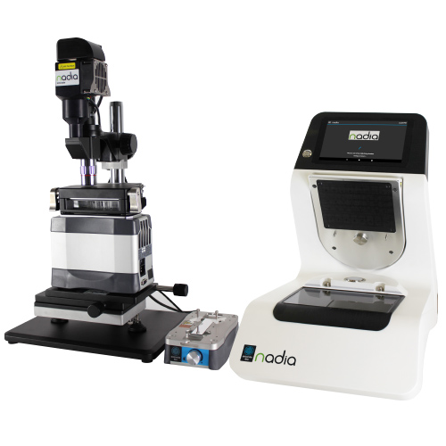
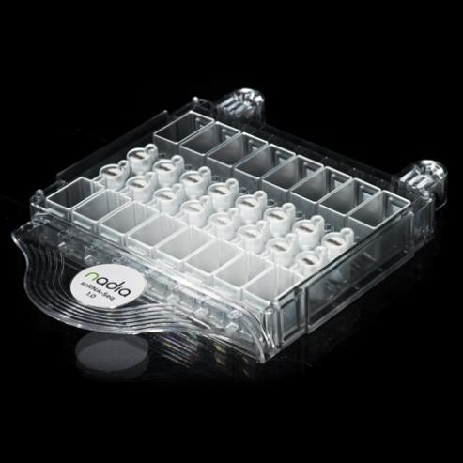
Library production: Single cell sequencing
Dolomite Bio Nadia Innovate
Commercialised version of original Drop-Seq system (Cell. 2015 May 21;161(5):1202-1214.)
System is a microdroplet encapsulator
Allows custom assay development
Can run 1, 2, 4 or 8 lanes in parallel

Slide 23
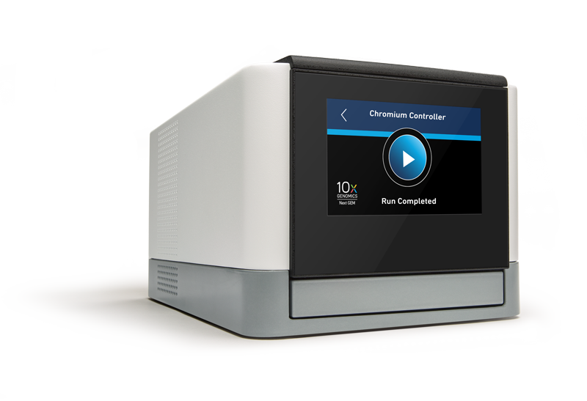
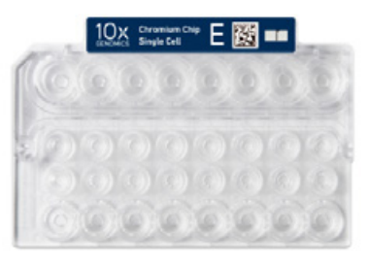
Library production: Single cell sequencing
10x Chromium
Modified Drop-Seq system, using gel beads and in droplet RT
System is a microdroplet encapsulator
Largely restricted to 10x assays
Can run 1 - 8 lanes in parallel

Slide 24
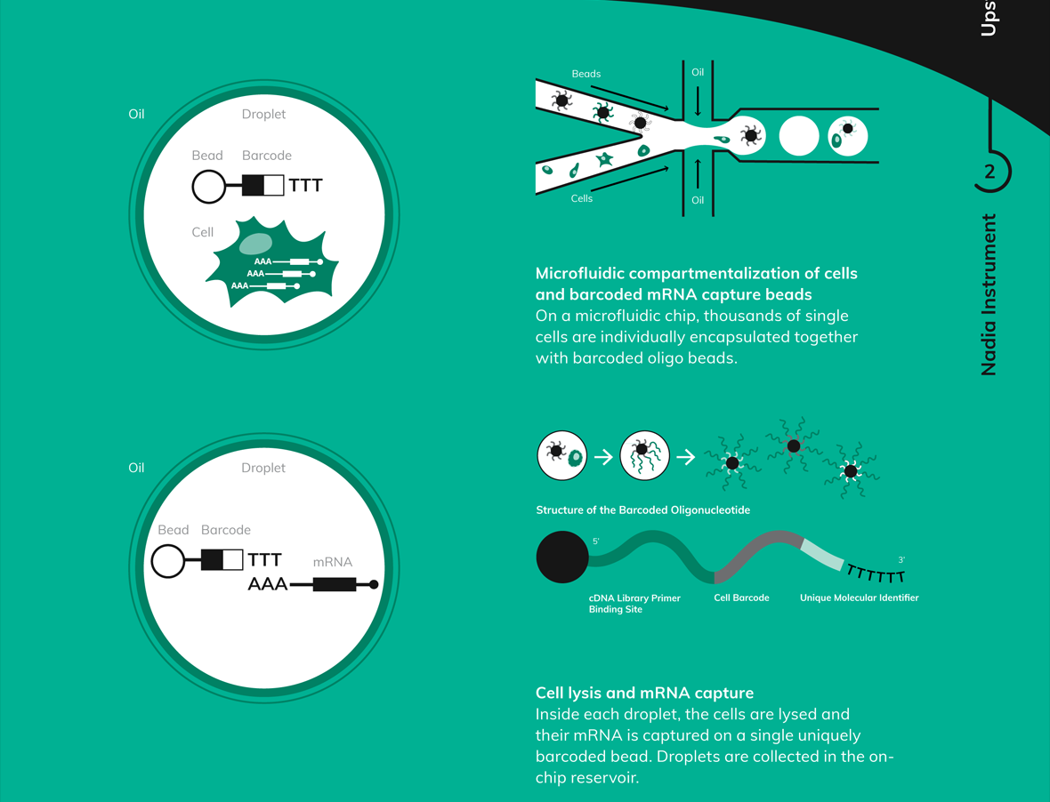
STAMP
(single-cell transcriptome attached to microparticles)

Slide 25
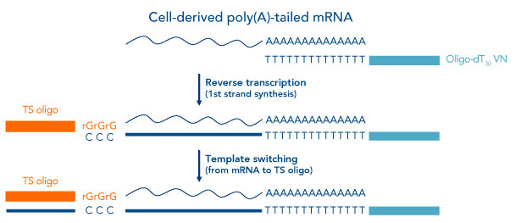
Prepare single cell suspension
@300 cells/ul
Wash beads & resuspend
in cell lysis buffer
@XXX beads/ul
Fill oil chamber & pre-run
Load 250 ul of cells and beads
1:20 droplets should contain
a cell. 1:20 droplets should contain a bead. 1:400 droplets
will contain both.
Run encapsulation
Transfer emulsion to 50 ml Falcon tube & add 30 ml SSC
Break emulsion with PFO
Centrifuge, remove upper layer, add 30 ml SSC
to resuspend beads, transfer upper layer to fresh tube
Large volumes minimises secondary RNA binding
Wash beads
Moloney murine leukemia virus (MMLV) reverse transcriptase
Reverse transcription with TSO
Exonuclease treatment
Digests bead primers that did not capture an RNA
PCR 2,000 beads/well (100 STAMPS)
AMPure XP bead clean-up
& Tapestation quantitation
Tagmentation
Fragments to ~300 bp
and adds adapters
Adds p5 and p7 sequences plus index
PCR
AMPure XP bead clean-up
& Tapestation quantitation
Sequence

Slide 26
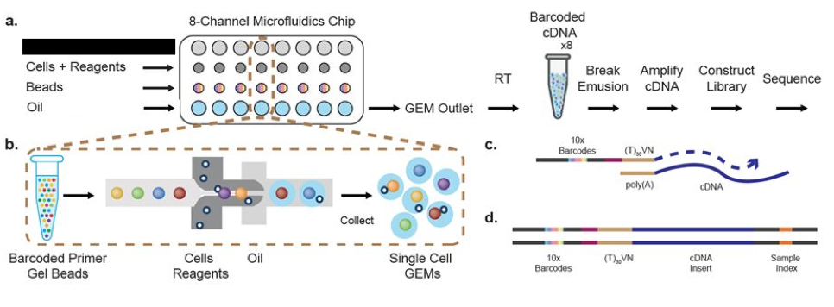

Slide 27
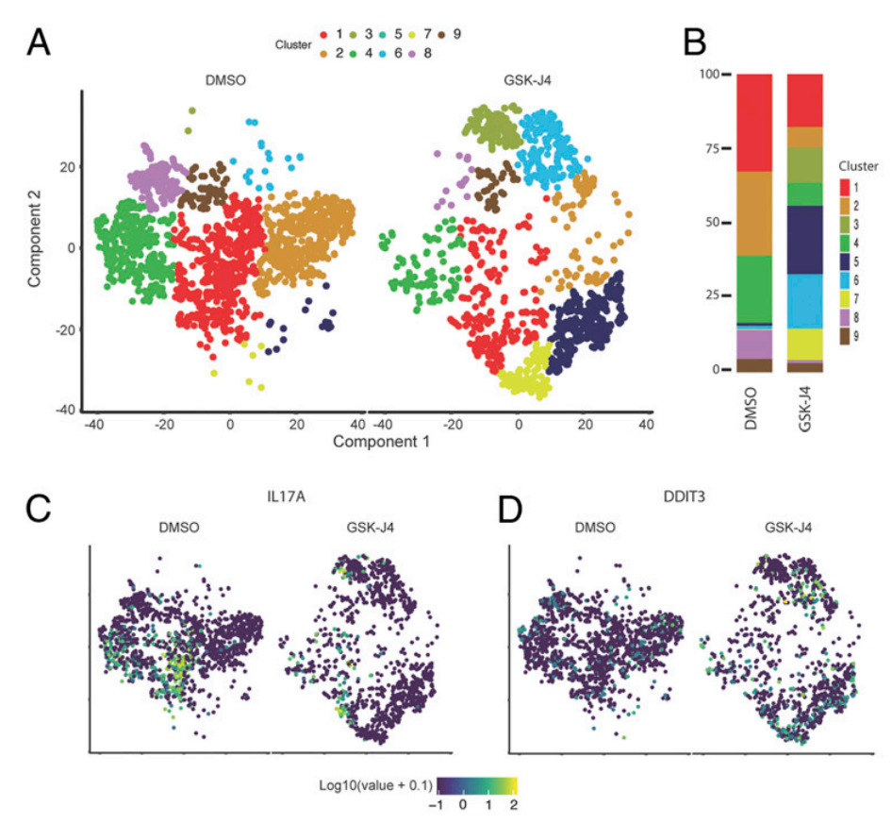
Histone H3K27me3 demethylases regulate human Th17 cell development and effector functions by impacting on metabolism
Proc Natl Acad Sci U S A. 2020 Mar 17;117(11):6056-6066.
Effect of GSK-J4 on CD4+ cells

Slide 28
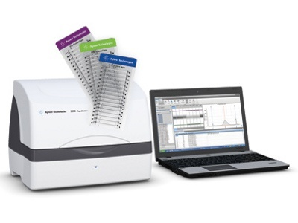
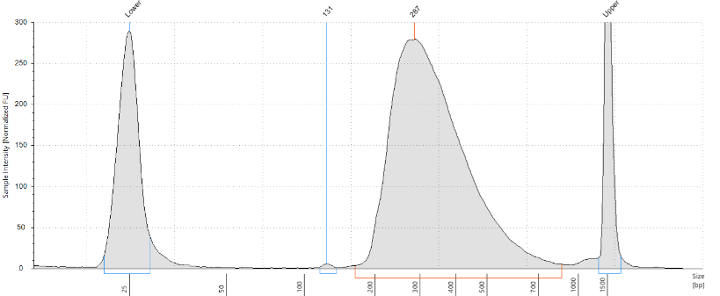
Library production: Quantitation and Pooling
Before any libraries can be sequenced, they need to be quantitated and (usually) pooled with other samples
Loading the right amount of pooled library is critical to optimal sequencing
Quantitation is performed on the Tapestation and samples are pooled such that they are all equimolar (assuming you want the same number of reads for each sample)

Slide 29
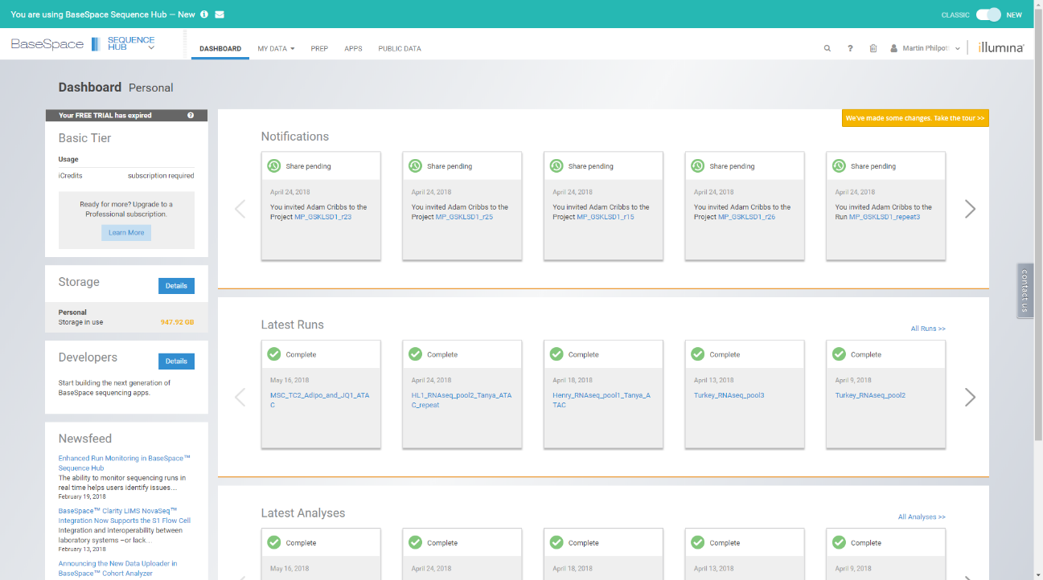
Sequencing: BaseSpace setup
BaseSpace is the Illumina web-base software for setting up and retrieving sequencing runs

Slide 30
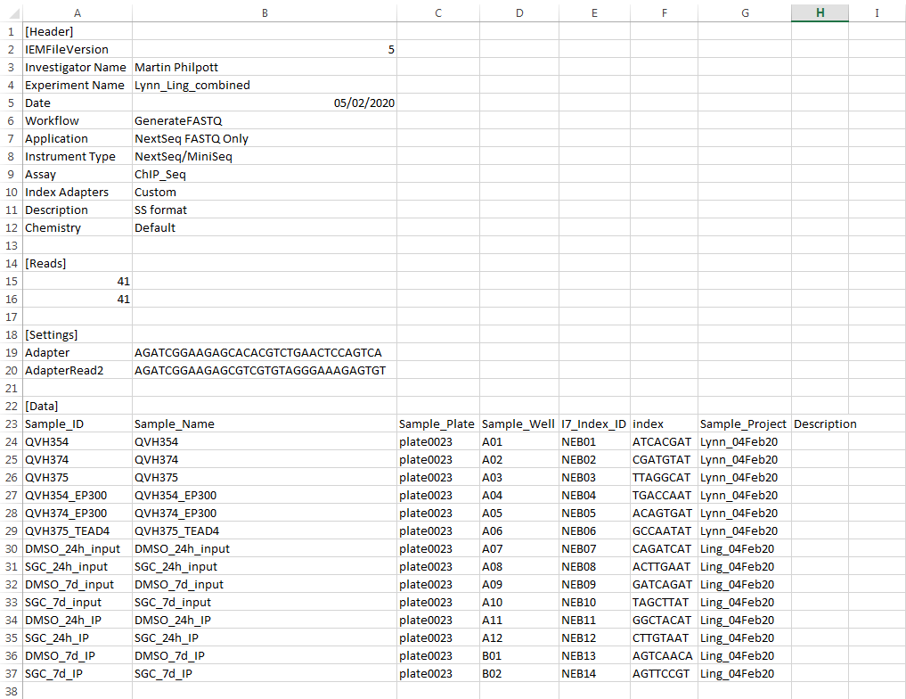

Slide 31
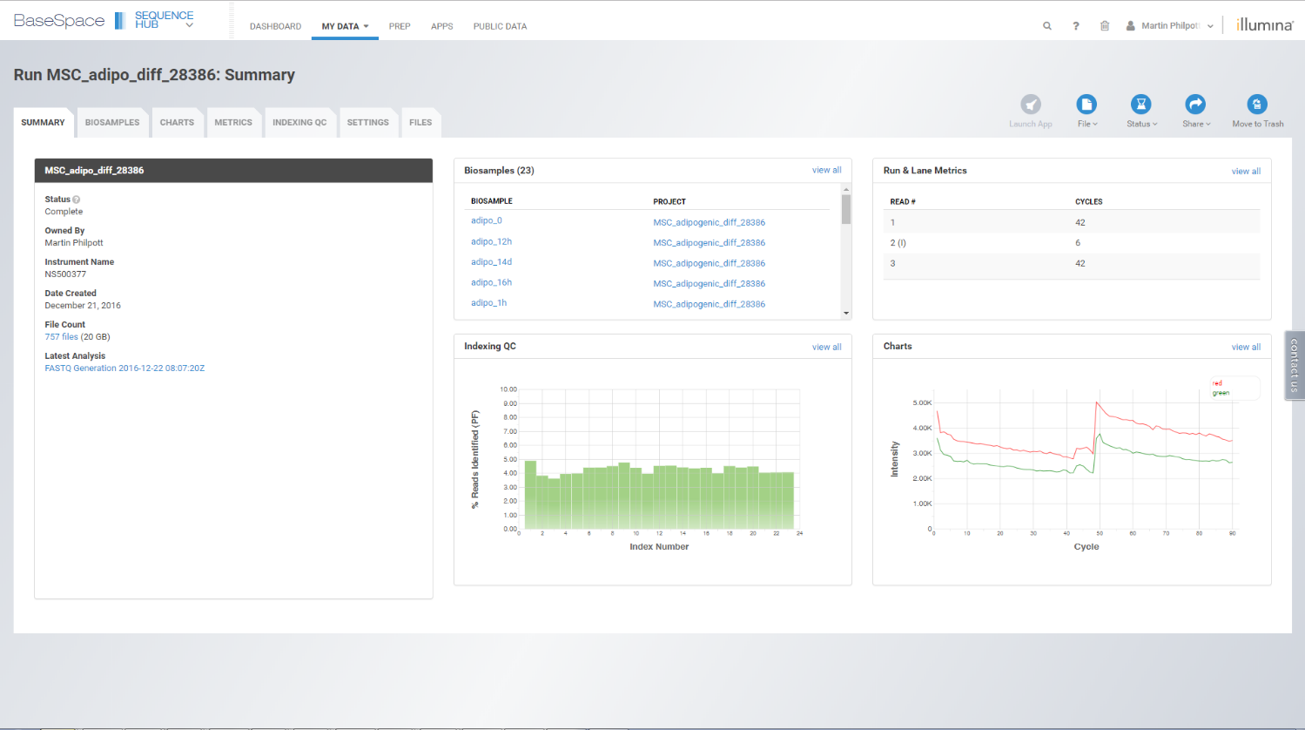

Slide 32
Oxford Nanopore Sequencing
3rd Generation sequencing
Long read sequencing (longest reported read >4 Mb)
High error rate (3-10%)
Genome sequencing
Complete and contiguous genome assemblies; de novo or reference guided
Resolve structural variants, breakpoints and repeat regions
Detect epigenetic modifications with direct sequencing and eliminate PCR bias
Targeted sequencing
PCR, hybrid-capture, CRISPR/Cas9 enrichment strategies
Large genomic regions and entire genes in single reads
Resolve structural variants, repetitive regions, SNVs and phasing
Gene expression
Full-length transcripts
unambiguous identification of splice variants and gene fusions
Eliminate PCR bias using direct cDNA or direct RNA sequencing
Identification of anti-sense transcripts and lncRNA isoforms
Full viral RNA sequence in one read
Long reads enhance viral identification from metagenomic samples

Slide 33
Oxford Nanopore Sequencing
https://www.youtube.com/watch?v=RcP85JHLmnI

Slide 34
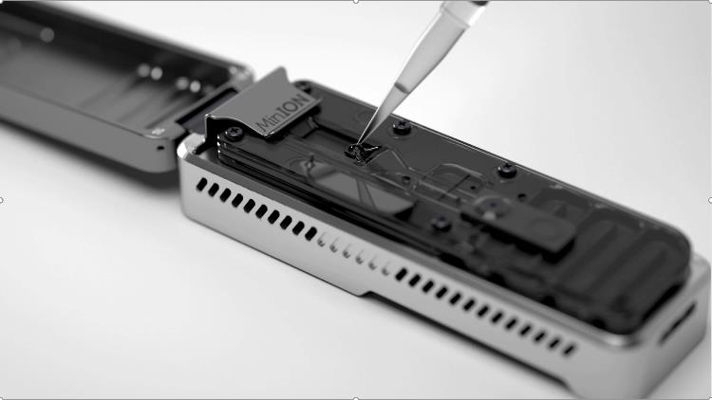
Oxford Nanopore Sequencing

Slide 35
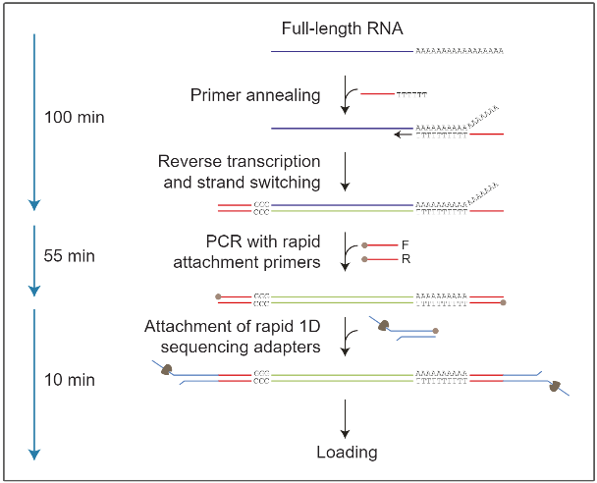
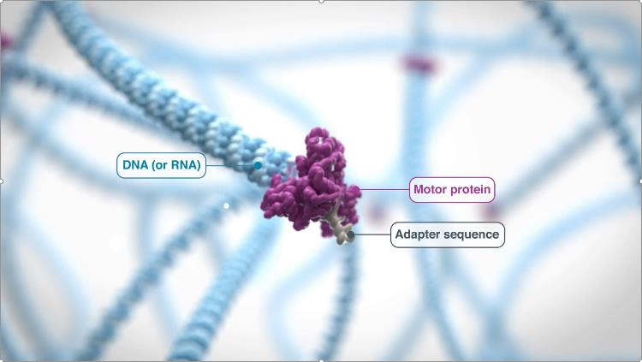
Oxford Nanopore Sequencing

Slide 36
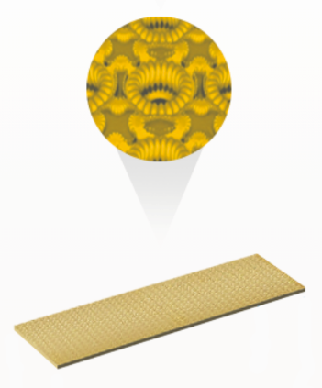


Oxford Nanopore Sequencing
Array of microscaffolds Each microscaffold supports a membrane and embedded nanopore.
Sensor chip Each microscaffold corresponds to its own electrode that is connected to a channel in the sensor array chip.

Slide 37


Oxford Nanopore Sequencing
Tether
Flush tether

Slide 38


Oxford Nanopore Sequencing
Motor protein
DNA polymerase (phi29 DNAP)
Helicase
Unzip dsDNA
ATP-dependent
Results in controlled ratcheting of ssDNA into the nanopore
Nanopore
Escherichia coli Curlin sigma S-dependent growth subunit G (CsgG)
Motor
electrically resistant polymer membrane

Slide 39

Oxford Nanopore Sequencing
Ionic current flows through the pore
DNA passing through the channel disrupts the flow of ions
MiniION
GridION
PromethION

Slide 40



Oxford Nanopore Sequencing
Current measured ~5000/second
Changes in current are converted to “squiggles”
Basecalling achieved by machine learning algorithms that identify patterns in the squiggles

Slide 41

Oxford Nanopore Sequencing
When strand passes fully through pore, motor protein is released and pore can sequence another strand

Slide 42
scBUC-seq; single cell Barcode Umi Correction sequencing
Existing droplet-based scRNAseq methods only sequence ends of transcripts (usually 3’)
Methods that cover entire transcripts are only practical for low cell numbers and still doesn’t assemble individual transcripts
Droplet-based whole transcript scRNAseq is highly desirable
Splice variants
~95% of multi-exonic genes are alternatively spliced
splice variants result in multiple protein isoforms from one gene that can have different functions
Translocations resulting in fusion proteins or transcripts

Slide 43
scBUC-seq; single cell Barcode Umi Correction sequencing
Existing droplet-based scRNAseq methods only sequence ends of transcripts (usually 3’)
Methods that cover entire transcripts are only practical for low cell numbers and still doesn’t assemble individual transcripts
Droplet-based whole transcript scRNAseq is highly desirable
Splice variants
~95% of multi-exonic genes are alternatively spliced
splice variants result in multiple protein isoforms from one gene that can have different functions
Translocations resulting in fusion proteins or transcripts
But scRNAseq requires high fidelity of barcode and UMI regions
Oxford Nanopore sequencing only 90-97% accurate
>70% of reads would be assigned to the wrong barcode

Slide 44



Our solution and basis of our products
patent pending: N420510GB
Synthesize oligos using blocks of dimer phosphoramidites
Highly accurate cell assignment
Uses two pass error correction
Allows cost-effective and accurate long-read single-cell sequencing using ONT platform
M Philpott, J Watson, A Thakurta, T Brown Jr, T Brown Sr, U Oppermann, AP Cribbs
Highly accurate barcode and UMI error correction using dual nucleotide dimer blocks allows direct
single-cell nanopore transcriptome sequencing (BioRxiv) - Nature Biotechnology (under revision)

Slide 45
NGS: Costs
 | RNAseq |  | ChIPseq | ATACseq | scRNAseq
 | polyA | rRNA depletion |  |  | Nadia (3,300 cells) | 10x (6500 cells) | In house (6,500 cells)
pre-library | 2 | 33 | 20-200 | 1 | 115 | 1100 | 73
library prep | 26 | 26 | 20 | 1 | 170 |  | 100
sequencing | 52 | 52 | 52 | 52 | 460 | 1,463 | 895
total/sample | £ 80 | £ 111 | £ 92-272 | £ 54 | £ 745 | £2,563 | £1,068
Typical experiment size | 24 | 24 | 24 | 24 | 8 | 8 | 8
Cost/experiment | £ 1,920 | £ 2,664 | £ 2,208-6,528 | £ 1296 | £ 5,960 | £20,504 | £8,544
Cost/cell |  |  |  |  | 0.23 | 0.39 | 0.16

